Slide 1


Implementation Of Audio Coding Using DPCM
Guided By: Dr .Merlin Gilbert Raj S,
Associative Professor
Dept ECE, KITS
V Franclin – URK22EC2001, ECE
M Joel Raj – URK22EC4024, ECE

Slide 2
Outline
Introduction
Problem Statement
DPCM Block Diagram
Market Survey
Implementation Of Audio Coding Using DPCM
Source Data
Flowchart
Performance Analysis
Results and Discussions
Conclusions
References
Acknowledgements

Slide 3
Introduction
Differential Pulse Code Modulation (DPCM) is a compression technique that encodes the difference between consecutive audio samples instead of each sample’s absolute value.
By predicting each sample based on the previous one, DPCM efficiently reduces data size since differences between samples are typically smaller and need fewer bits.
This approach is commonly used in audio and video compression to save bandwidth and storage while maintaining a reasonable quality level.

Slide 4
Problem Statement
With growing demand for efficient audio transmission and storage, audio coding techniques are needed to reduce data size without quality loss.
Traditional PCM requires high bit rates, which limits its use in low-bandwidth or low-power applications.
DPCM offers a solution by encoding only the differences between samples, reducing redundancy.
This research evaluates DPCM's effectiveness in achieving efficient compression while maintaining quality, especially for bandwidth- and resource-limited applications.

Slide 5
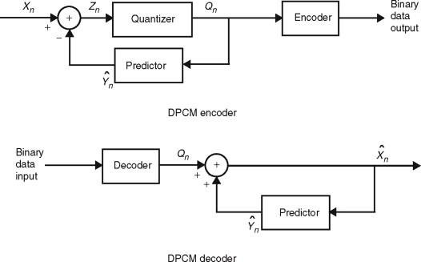
DPCM Block Diagram

Slide 6
Market Survey
Before DPCM, audio coding often used PCM (Pulse Code Modulation) for raw waveform representation, along with pre-emphasis filtering and adaptive quantization to optimize data.
During and after DPCM, ADPCM (Adaptive DPCM) improved efficiency by dynamically adjusting predictions and quantization.
Modern codecs now build on DPCM principles, integrating complex prediction and compression models for higher-quality audio.

Slide 7
Implementation Of Audio Coding Using DPCM
Here, we have used “.wav” sample audio file.
In DPCM audio coding, each sample(.wav file) is predicted from previous samples, and only the difference between the predicted and actual sample is encoded.
This difference is quantized to reduce data size, then encoded and stored.
During decoding, these differences are added back to reconstruct the audio signal, achieving compression by encoding smaller values.

Slide 8
Source Data
In DPCM audio coding, the source data is typically a raw audio signal in Pulse Code Modulation (PCM) format, such as a .wav file.
Here, 11sec of the sample audio is used for sampling.
This PCM data represents the amplitude of the audio waveform at fixed intervals, using uniform sampling.
The DPCM process then takes each of these PCM samples and predicts their values based on previous samples.

Slide 9
Flowchart
Start
Load the Audio
File Exist
Read sample rate and audio data
Audio format is int16
Normalize audio to int16 format
Sampling the audio
Plot original, sampled, quantized, encoded and decoded signals
Save Successful
Calculate SQNR and MSE
DPCM Encoding and Decoding
Quantizing the audio
Display SQNR and MSE
END
END

Slide 10
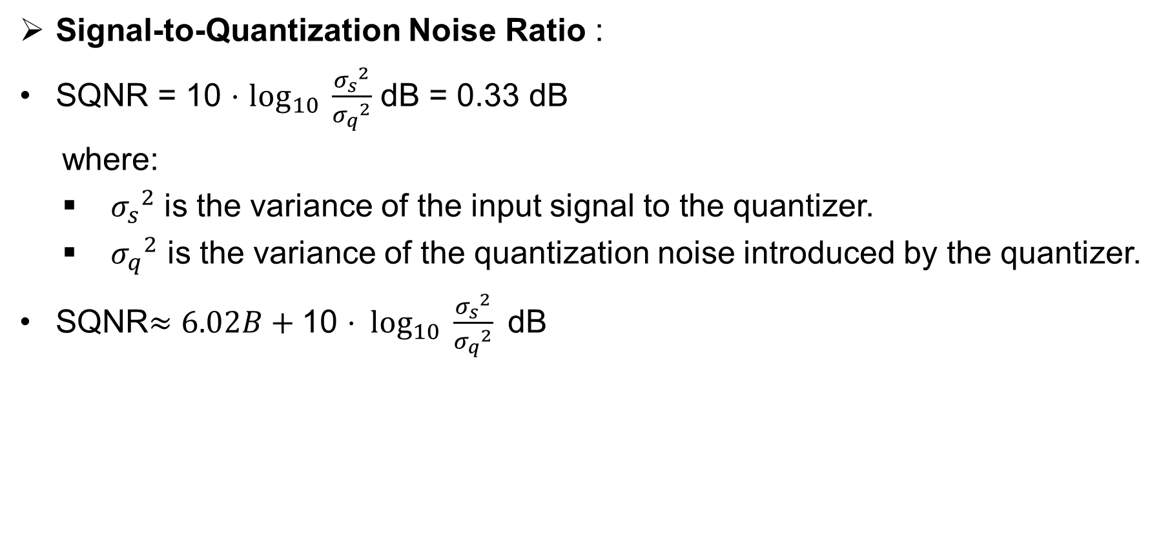
Performance Analysis
Signal-to-Quantization Noise Ratio :
SQNR = 10 ⋅ $\log_{10}{\frac{{σ_{s}}^{2}}{{σ_{q}}^{2}}}$ dB = 0.33 dB
where:
${σ_{s}}^{2}$​ is the variance of the input signal to the quantizer.
${σ_{q}}^{2}$​ is the variance of the quantization noise introduced by the quantizer.
SQNR$≈6.02B+\text{10 ⋅ }\log_{10}{\frac{{σ_{s}}^{2}}{{σ_{q}}^{2}}} \text{dB}$

Slide 11
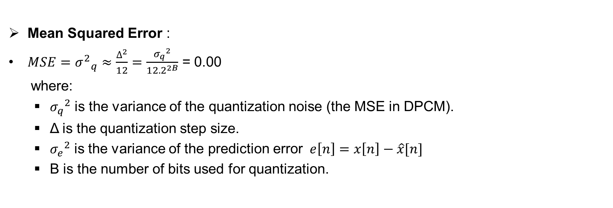
Performance Analysis
Mean Squared Error :
$MSE=​{σ^{2}}_{q}^{}≈\frac{∆^{2}}{12}=\frac{{σ_{q}}^{2}}{12{.2}^{2B}}$​​ = 0.00
where:
${σ_{q}}^{2}$ is the variance of the quantization noise (the MSE in DPCM).
Δ is the quantization step size.
${σ_{e}}^{2}$​ is the variance of the prediction error $e\left[n\right]=x\left[n\right]−\hat{x}[n]$
B is the number of bits used for quantization.

Slide 12
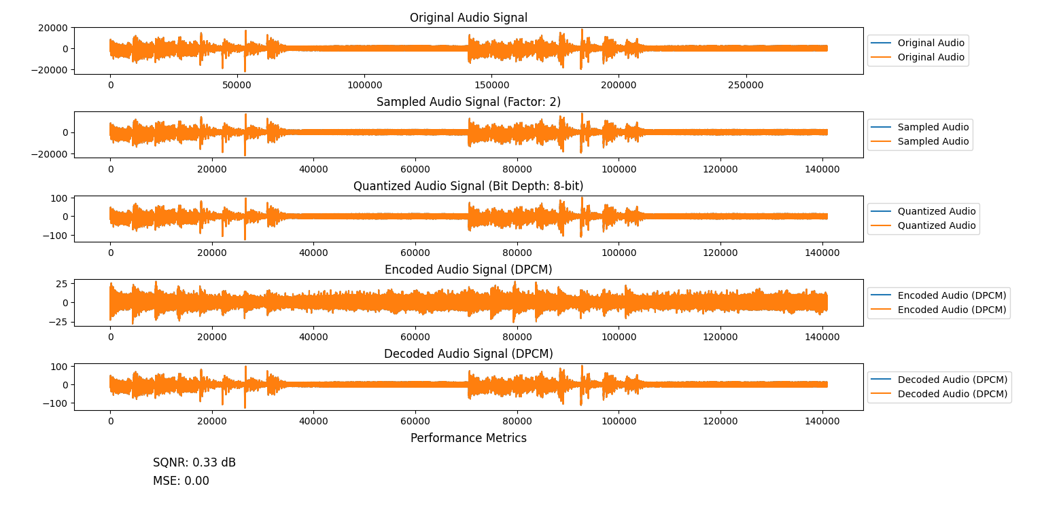
Results and Discussions
DPCM compresses audio by encoding differences between samples, making it efficient for low-bandwidth applications like telecommunications.
It balances simplicity and moderate quality but is less suitable for high-fidelity audio compared to advanced codecs.

Slide 13
Conclusions
DPCM effectively compresses audio by encoding sample differences, making it useful in applications needing moderate quality with low complexity, like telecom and embedded systems.
Its simplicity and efficiency keep it relevant for bandwidth-constrained uses.

Slide 14
References
https://elenacamuffo.github.io/download/MC.pdf
https://www.pce-fet.com/common/library/books/34/1314_[Marina_Bosi,__Richard_E._Goldberg__(auth.)]_Intro(b-ok.org).pdf

